Slide 1

Massachusetts’ New Economy
Jim Stergios, Executive Director
Findings from our series on the Commonwealth’s long-term job-creation trends

Slide 2
Section 1: Overview of Jobs and Unemployment in MA and the US
Section 2: A Tale of Two Economies
Section 3: The Devastating Recession, Our Underwhelming Recovery
Section 4: What a Drag It Is Being Massachusetts
Section 5: Massachusetts’ “New Economy”
Section 6: What Now?

Slide 3
Highest MA Unemployment Number Ever
>80,000 (150,000) More Unemployed than Pre-recession Low
Source: US Bureau of Labor Statistics, Local Area Unemployment Statistics

Slide 4
Employment Dipped to Lowest Level Since Late ’90s
We Still Need 80,000 Jobs
Source: US Bureau of Labor Statistics, Local Area Unemployment Statistics

Slide 5
MA Employment: 6% Growth Since Early ’90s
Current Recovery Still Lags

Slide 6
US Employment: Strong Growth Since Early 90s (21%)
MA Slow at 6%: Has Hit a Ceiling?

Slide 7
Section 1: Overview of Jobs and Unemployment in MA and the US
Section 2: A Tale of Two Economies
Section 3: The Devastating Recession, Our Underwhelming Recovery
Section 4: What a Drag It Is Being Massachusetts
Section 5: Massachusetts’ “New Economy”
Section 6: What Now?

Slide 8
Unemployment Rates by Metropolitan Areas
Large Regional Variations

Slide 9
Section 1: Overview of Jobs and Unemployment in MA and the US
Section 2: A Tale of Two Economies
Section 3: The Devastating Recession, Our Underwhelming Recovery
Section 4: What a Drag It Is Being Massachusetts
Section 5: Massachusetts’ “New Economy”
Section 6: What Now?

Slide 10
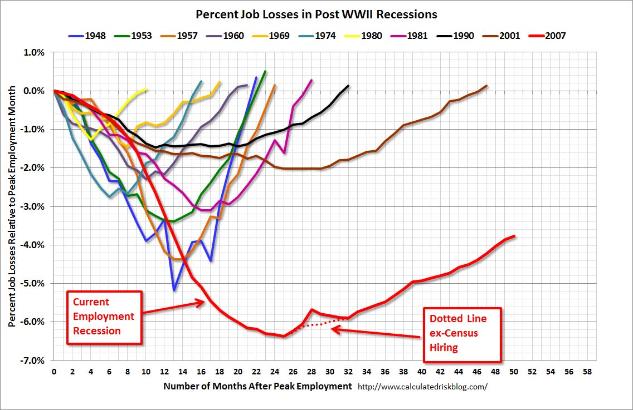
Depth and Duration of Recessions
U.S Taking Ever Longer to Recover Jobs from Recessions

Slide 11
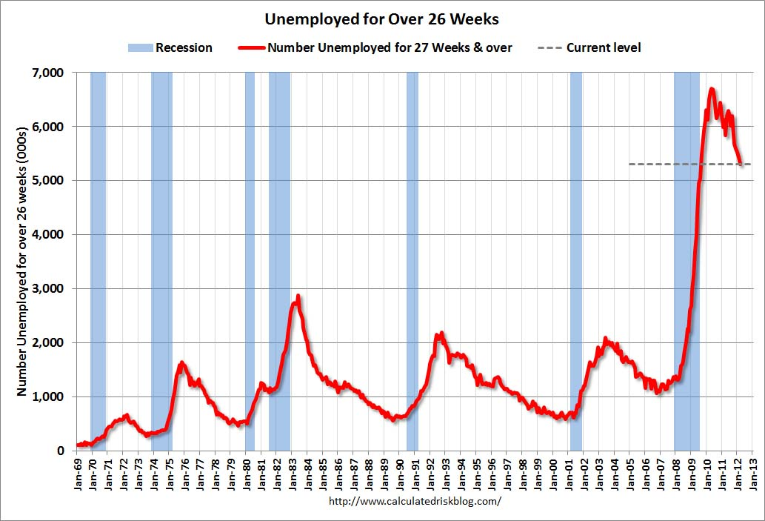
US Average Duration of Unemployment at Record Levels

Slide 12
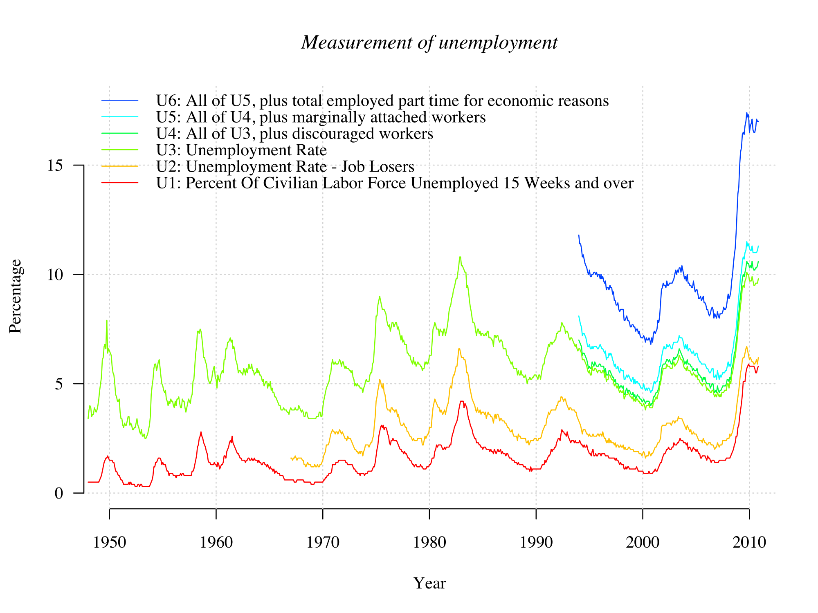
Underemployment Rate Has Spiked
Spread over Traditional Unemployment Has Widened
Source: Chart by “Autopilot” based on BLS data

Slide 13
Section 1: Overview of Jobs and Unemployment in MA and the US
Section 2: A Tale of Two Economies
Section 3: The Devastating Recession, Our Underwhelming Recovery
Section 4: What a Drag It Is Being Massachusetts
Section 5: Massachusetts’ “New Economy”
Section 6: What Now?

Slide 14
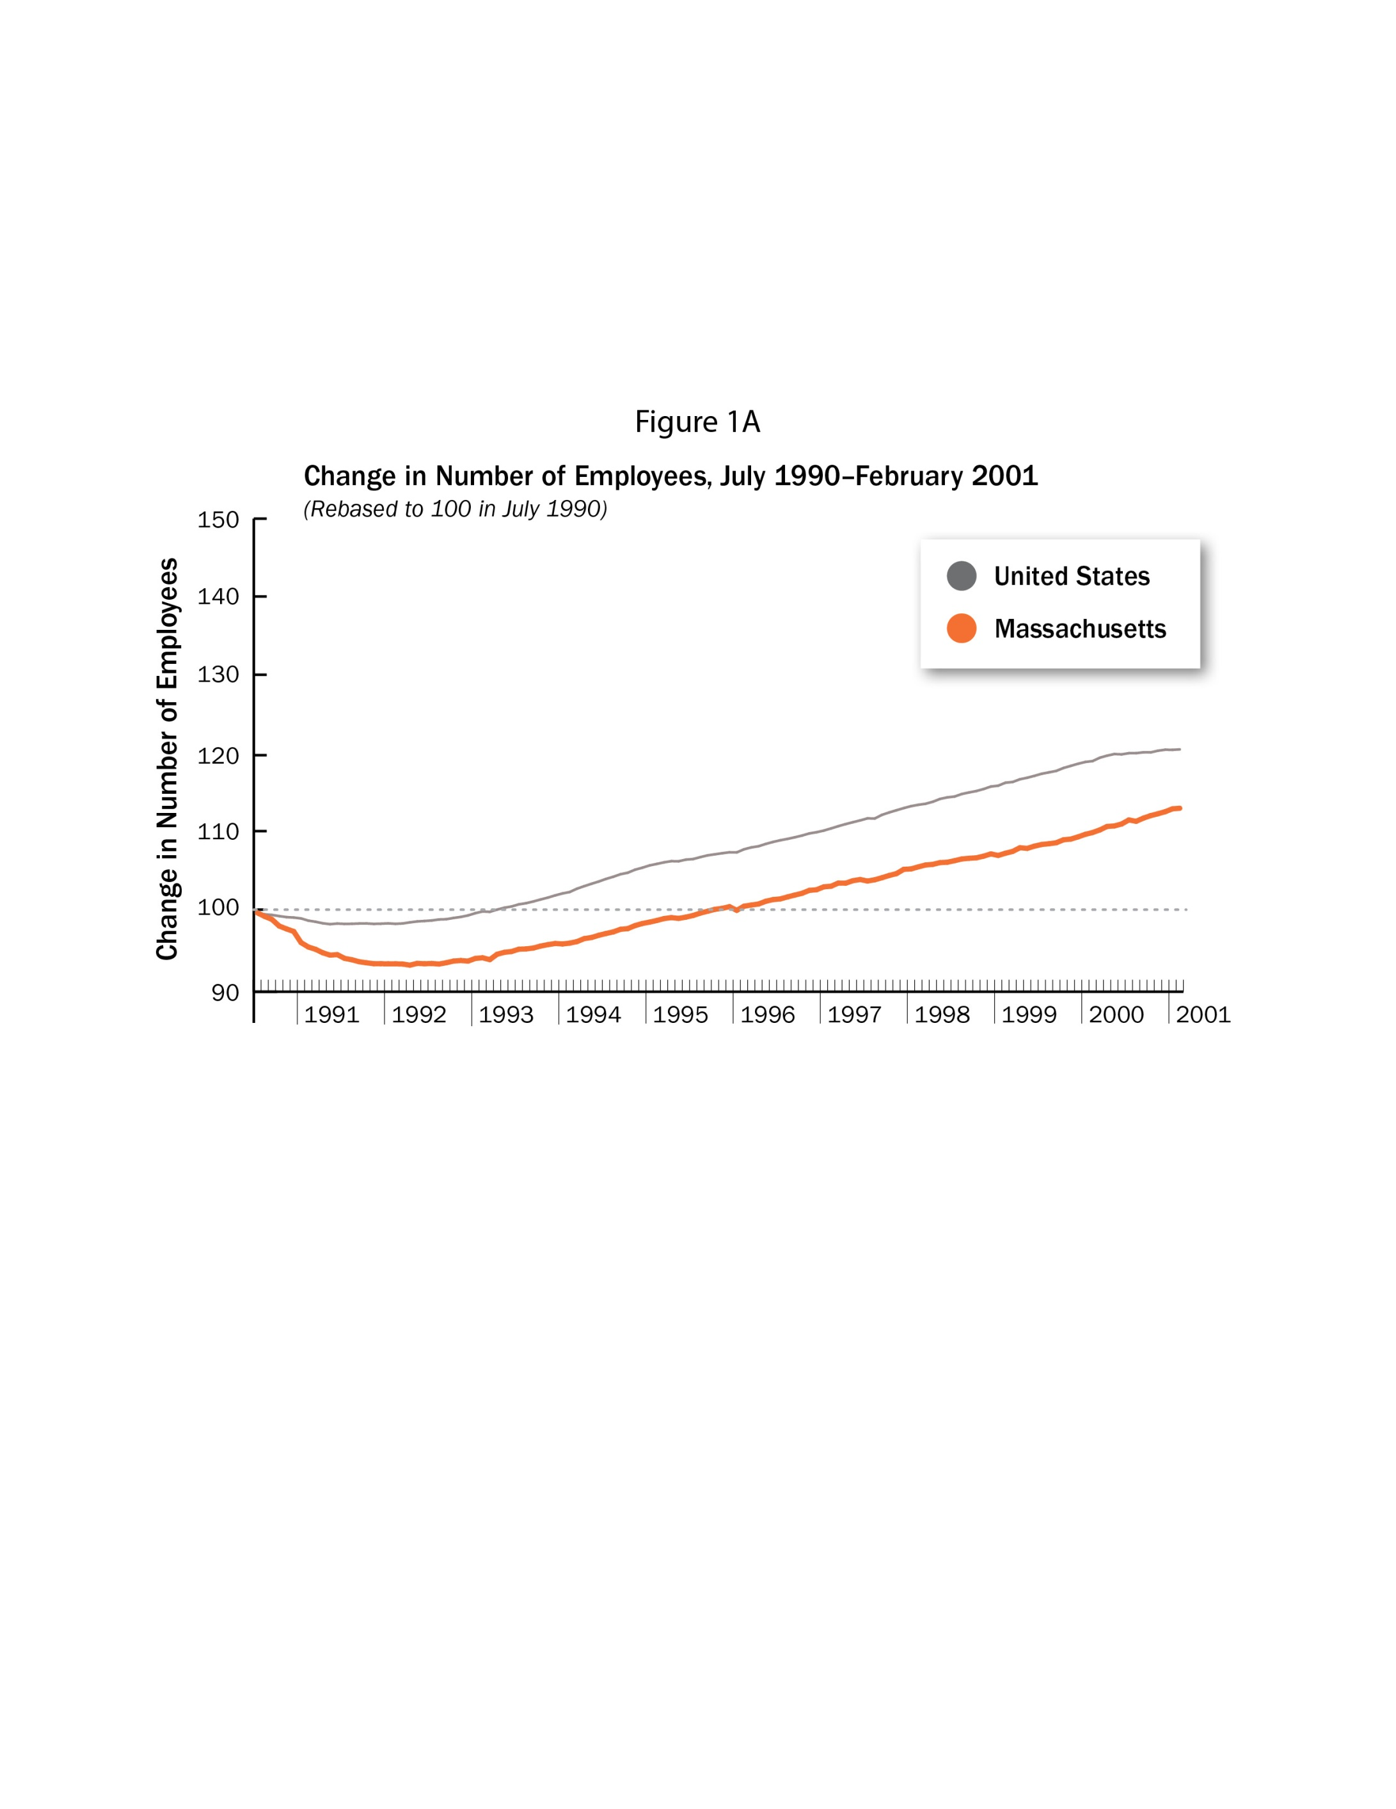
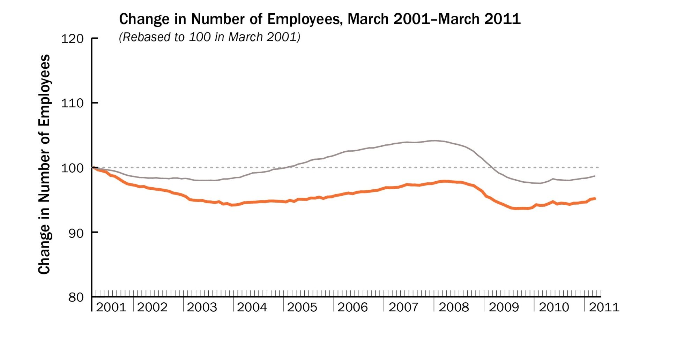
Depth and Duration of Recessions: The US vs MA
Source: US Bureau of Labor Statistics, Local Area Unemployment Statistics

Slide 15
Section 1: Jobs and Unemployment in Massachusetts and the US
Section 2: A Tale of Two Economies
Section 3: A Devastating Recession and An Underwhelming Recovery
Section 4: What a Drag It Is Being Massachusetts
Section 5: Massachusetts’ “New Economy”
Section 6: Quo Vadis?

Slide 16
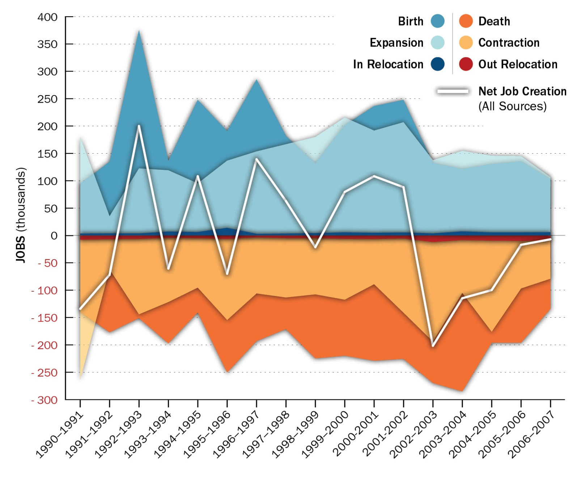
Massive Job Flux: Each Year, 17% of Jobs Created/Destroyed

Slide 17
Little Net Effect Over 20 Years on Job Creation

Slide 18
Firm Relocation Effects Are Relatively Minor

Slide 19
Evidence of a Startup/Entrepreneurship Problem

Slide 20
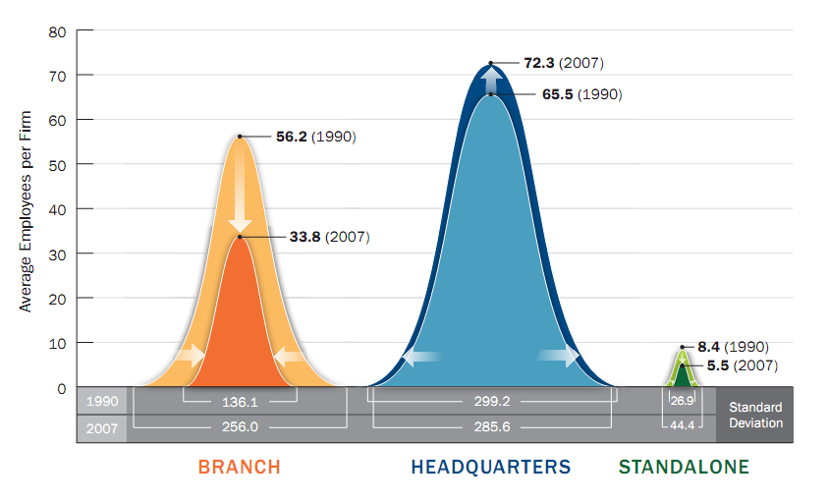
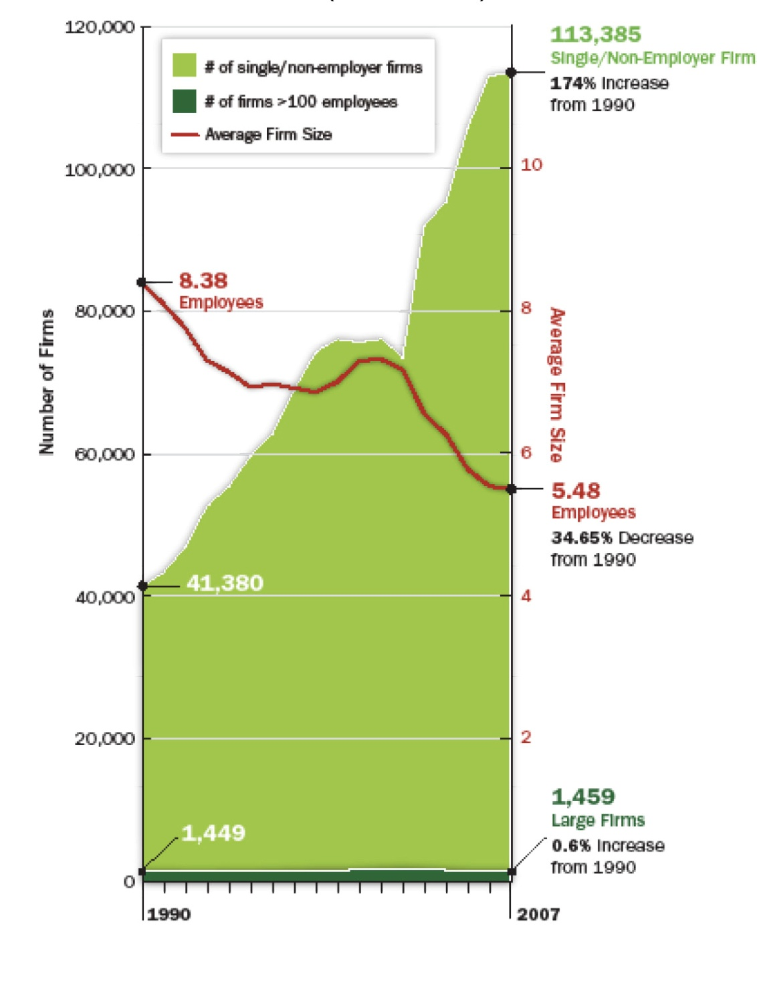
Decreasing Firm Size
&
Rise of Nonemployer Firms

Slide 21
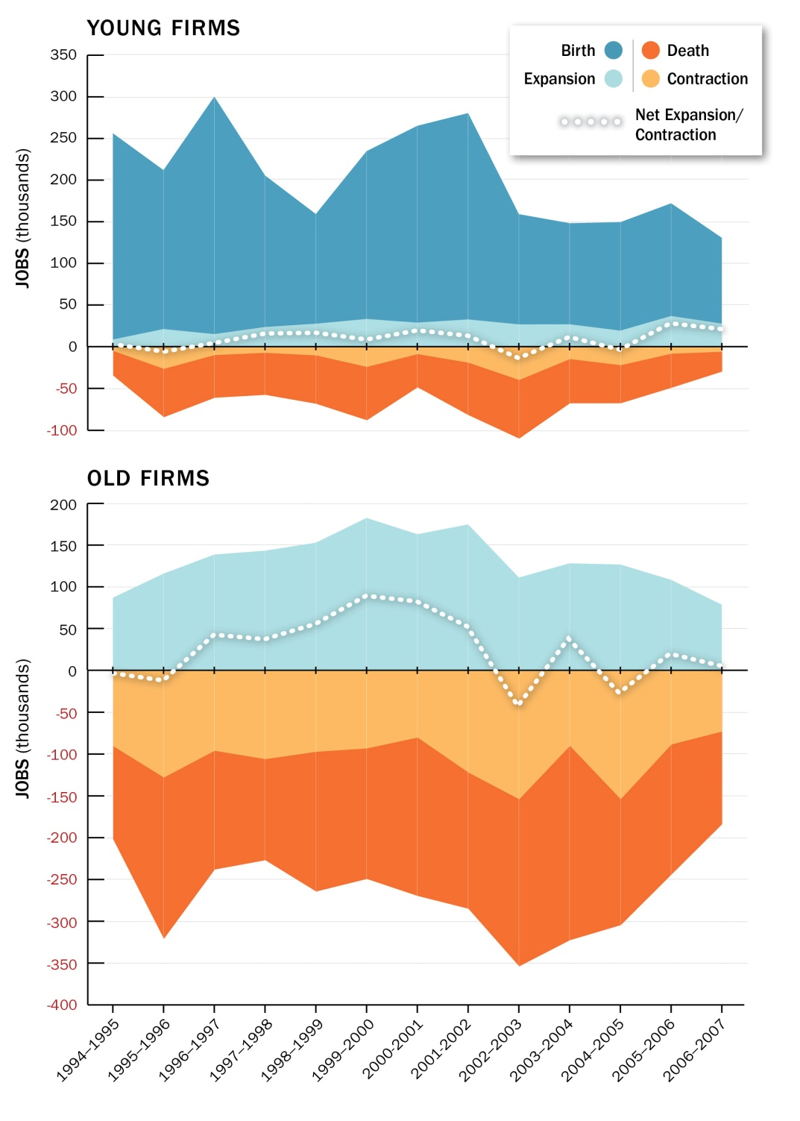
Post-recession Jobs Come From Young Firms

Slide 22
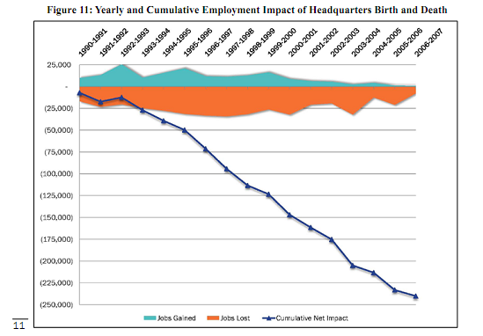
Loss of 5,000 Headquarters Has Cost MA 250,000 jobs
HQ’ed businesses: 16,000 in 1990.
11,000 in 2007.

Slide 23
Section 1: Overview of Jobs and Unemployment in MA and the US
Section 2: A Tale of Two Economies
Section 3: The Devastating Recession, Our Underwhelming Recovery
Section 4: What a Drag It Is Being MA
Section 5: Massachusetts New Economy
Section 6: What Now?

Slide 24
Current Economic Policy focuses on “Sweet Spot” Industries
(Their share of current employment)

Slide 25
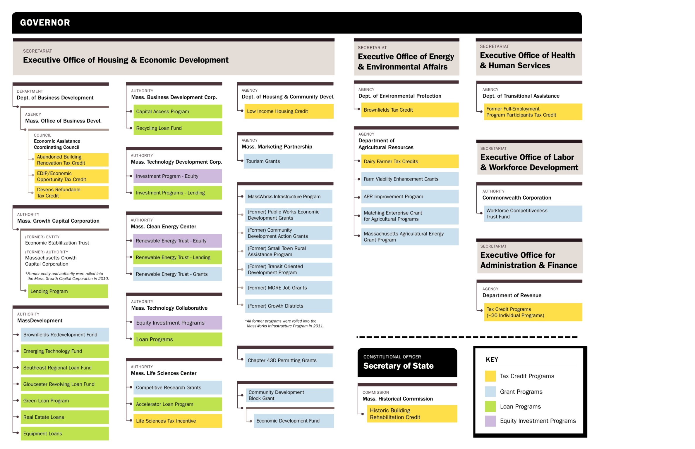
Current Economic Policy - State financing structure
for specific industries is complex and lacks accountability

Slide 26
A Better Approach
Corporate Taxes
MHTC survey showed tax environment as key factor; business leaders sought consistent and low tax rate and low business costs.
Trade-off of tax expenditure reforms for lower corporate rate?
Unemployment Insurance
Seek reforms to bring eligibility and benefit levels in line with national norms.
Current effort by administration applies only to public sector employees.
Regulation
Keep careful eye on current Administration initiative.
Business groups must engage in the process and identify regulatory hurdles.
Healthcare
Seek to reform or remake Connector to promote a real marketplace with robust competition and cost savings.
Focus on the Board of the Connector.

