Slide 1
October 2013
Lessons from New Orleans

Slide 2
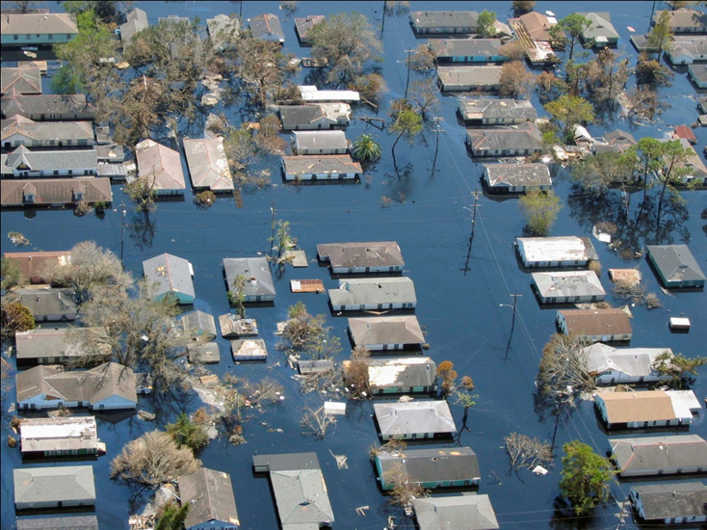
The Worst Natural Disaster in Our Country’s History

Slide 3
Fixing the System Itself
Dysfunctional
System
District
Leaders
Charter schools
Well Meaning Actors
Unions
Teachers
Students

Slide 4
We Handed Power Back
Educators run schools
Parents choose amongst these schools
Government regulates for performance and equity

Slide 5
Did it work?

Slide 6
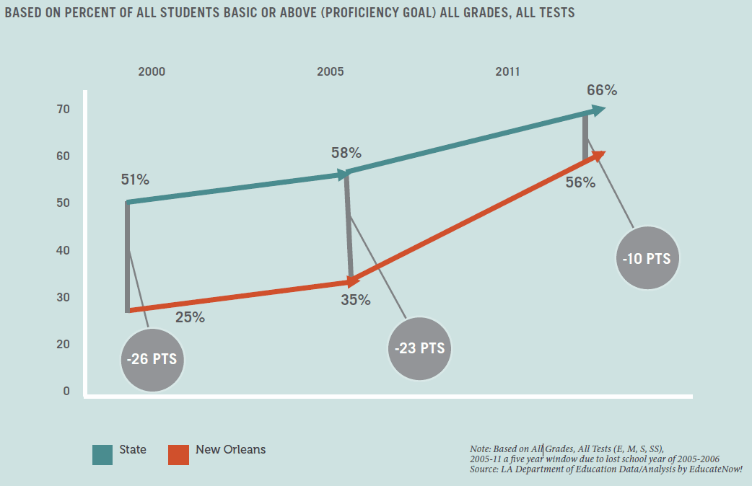
Over 4X Gap Closing Since 2005
Since 2005, New Orleans has been closing the city-state achievement gap at over 4 times the pre 2005 rate.

Slide 7
Are students less at-risk?

Slide 8
Poverty Rates Have Increased Since the Storm

Slide 9
And New Orleans Citizens are Experiencing a Mental Health Crisis
Researchers found very high levels of mental illness among the population:
Nearly 40 percent had probable mental illness one year after the storm, and half of these illnesses were classified as severe.
These rates were substantially higher than rates of mental illness prior to Hurricane Katrina in the Gulf States region. According to the National Comorbidity Survey Replication study conducted between 2001 and 2003, rates of severe, moderate, and any mental illness were estimated at 6 percent, 10 percent, and 16 percent, respectively.
The high levels of mental illness suggest that the prevalence of mental illness may not have declined in the year following the hurricane – finding that differs from the pattern described in most previous research on mental illness following disasters.

Slide 10
Are schools getting more Money?

Slide 11
The Funding Differential Between NOLA and State is Near 2002 Levels

Slide 12
Putting it All Together
Higher % of students with free and reduced lunch…
Citizens suffering from a severe mental health crisis…
No major shifts in city-state funding ratios…
And New Orleans is closing gap with the state over 4X faster than pre-storm

Slide 13
Did it work Because of charter schools?

Slide 14
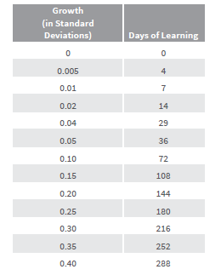
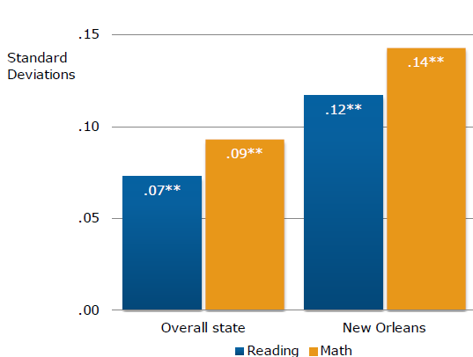
New Orleans: ~5 Months of Extra Learning and 90% Market Share

Slide 15
Recommendations for Massachusetts

Slide 16
Create a RSD to Fix the System Itself
Dysfunctional
System
District
Leaders
Charter schools
Well Meaning Actors
Unions
Teachers
Students

Slide 17
The Future of Boston Public Schools

Slide 18
New Orleans: ~5 Months of Extra Learning and 90% Market Share

Slide 19
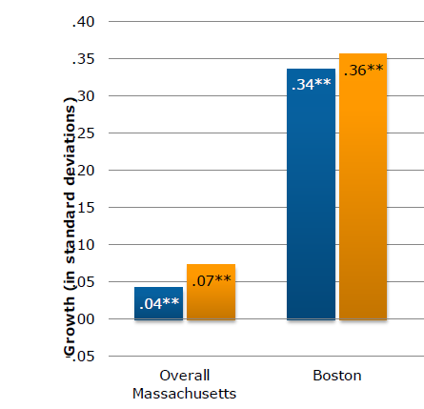
Boston: ~12 Months of Extra Learning at 10% Market Share

Slide 20
Boston Could Be the Highest Performing Urban District in the Country
Boston 2013 = ~135 schools Current Cap: 18% market share (~25 schools)
5% Charter Market Share Growth: 7 schools a year
Boston 2023: 68% charters / 32% district

